Slide 1
Numerical Heat Conduction
Advanced Heat Transfer
Mid Semester Project
By:
Abhishek Yadav
Roll no: 2502103031
Thermal Energy Systems
1st Semester

Slide 2
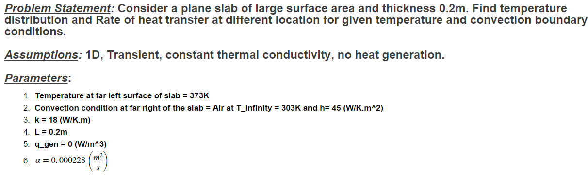
A. Transient Heat Conduction through Plane Slab

Slide 3


Diagram
$T_{1}=373K$ $T_{∞}=303K$
$h=45 (W/m^2K)$
$$k=18$$
$$q_{gen}=0(W/m^3)$$
$$α=0.000228\left(\frac{m^{2}}{s}\right)$$
$$T_{0}=303K$$
L = 0.2m

Slide 4
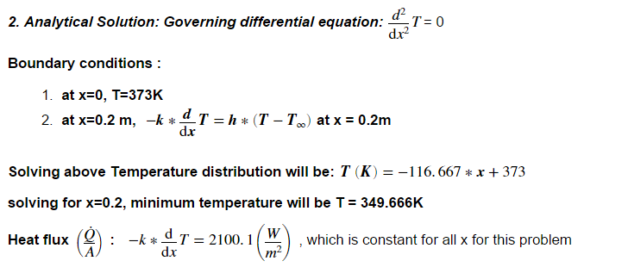
Analytical solution for steady state condition:

Slide 5
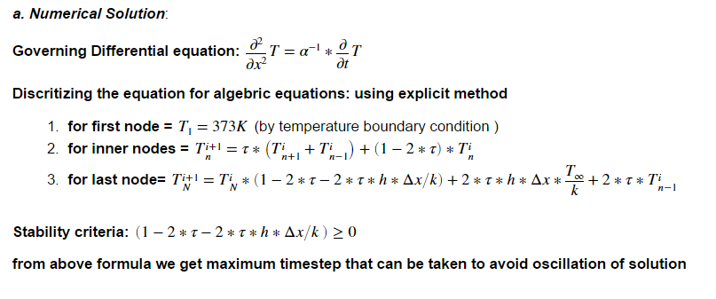
Transient state condition:

Slide 6
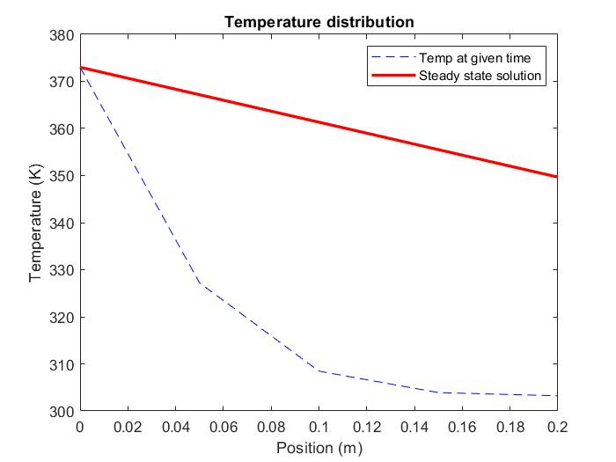
Temperature plots at different times w.r.t to Steady state solution for time 0.1 min

Slide 7
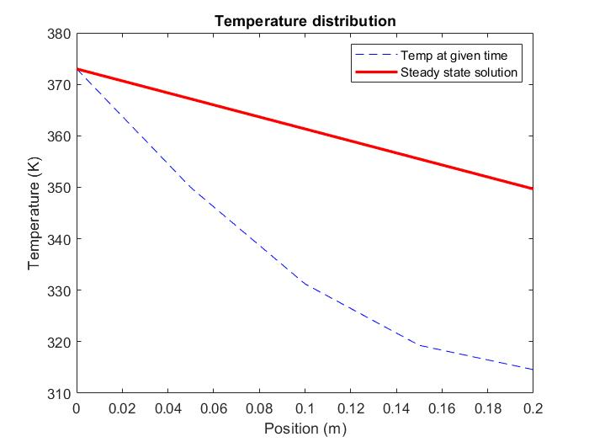
For time 0.5 min

Slide 8
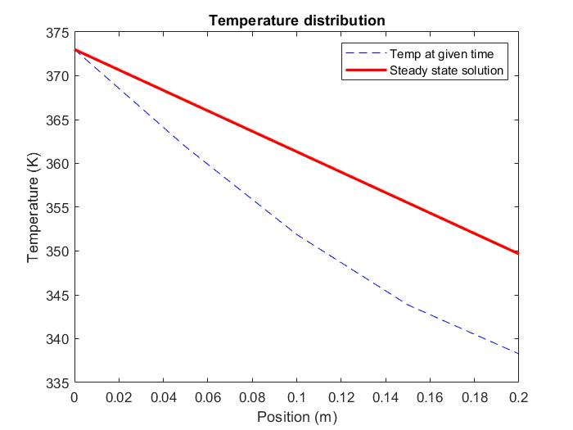
for time 1.5 min

Slide 9
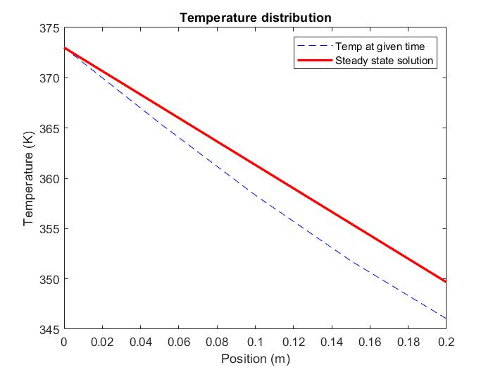
For time 2.5 min

Slide 10
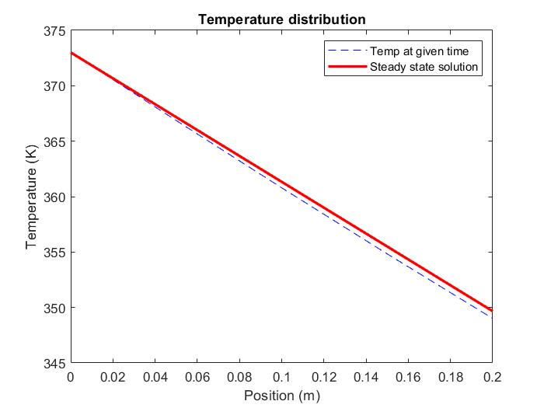
For 4 min

Slide 11
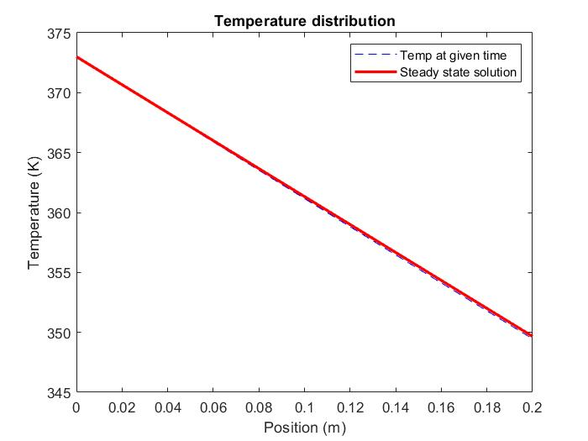
For 5 min

Slide 12
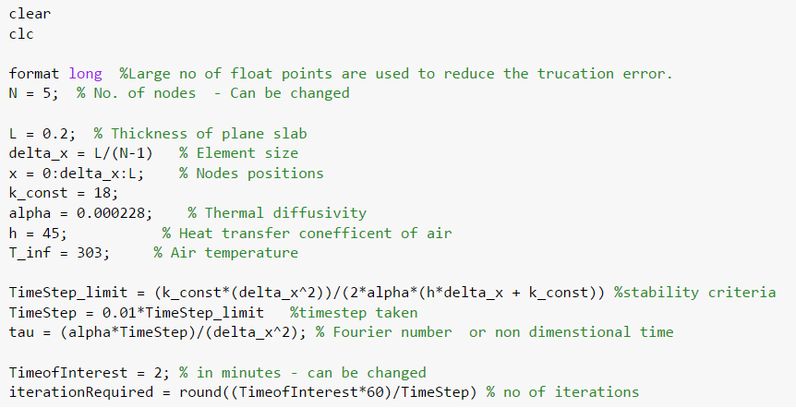
Code:

Slide 13
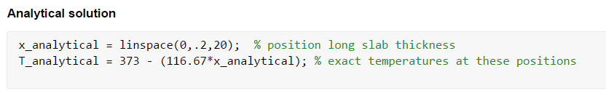

Slide 14
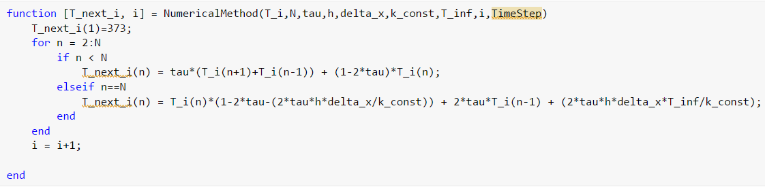

Slide 15
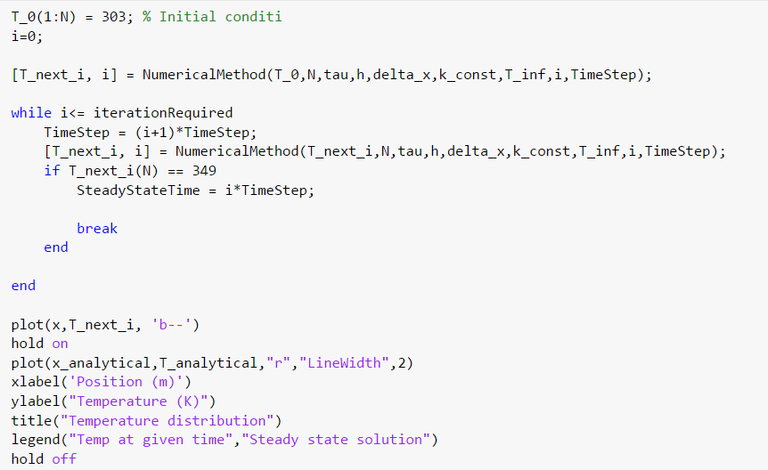

Slide 16
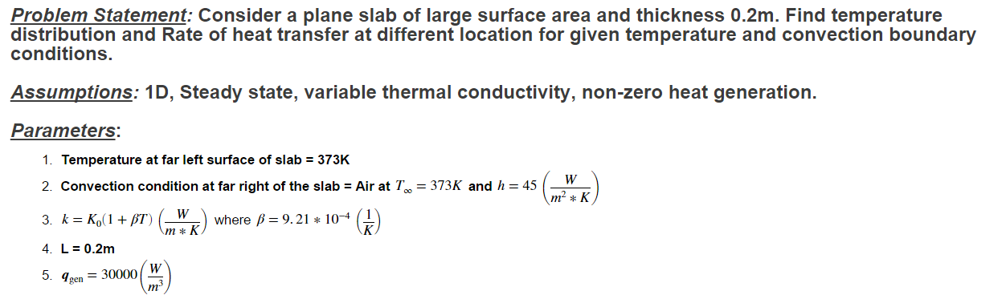
B. Steady state head conduction with variable Thermal conductivity and Heat generation

Slide 17
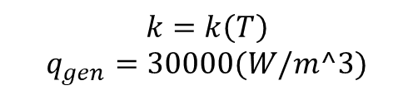
Diagram
$T_{1}=373K$ $T_{∞}=303K$
$h=45 (W/m^2K)$
$$k=k\left(T\right)$$
$$q_{gen}=30000(W/m^3)$$
L = 0.2m

Slide 18
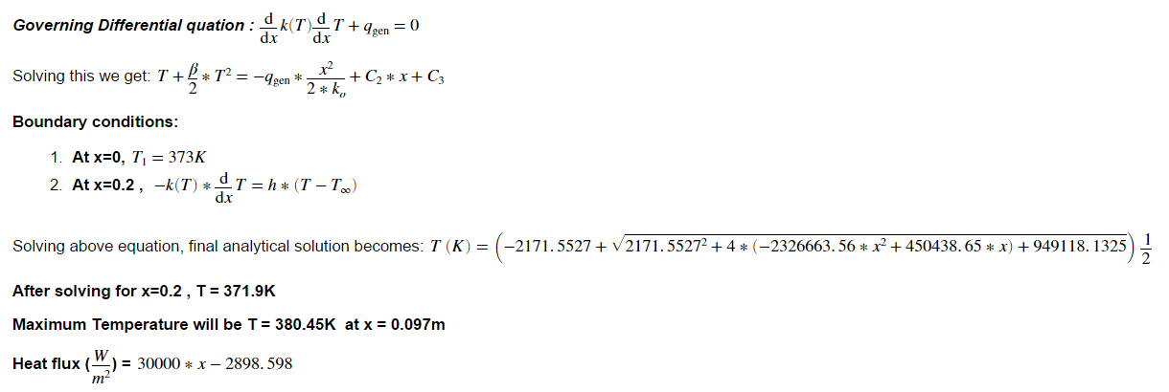
Analytical Solution

Slide 19
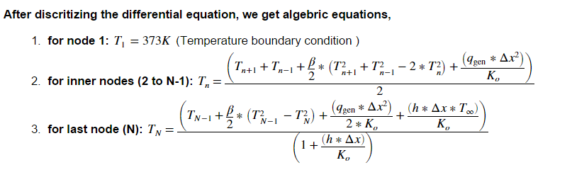
Numercial Solution

Slide 20
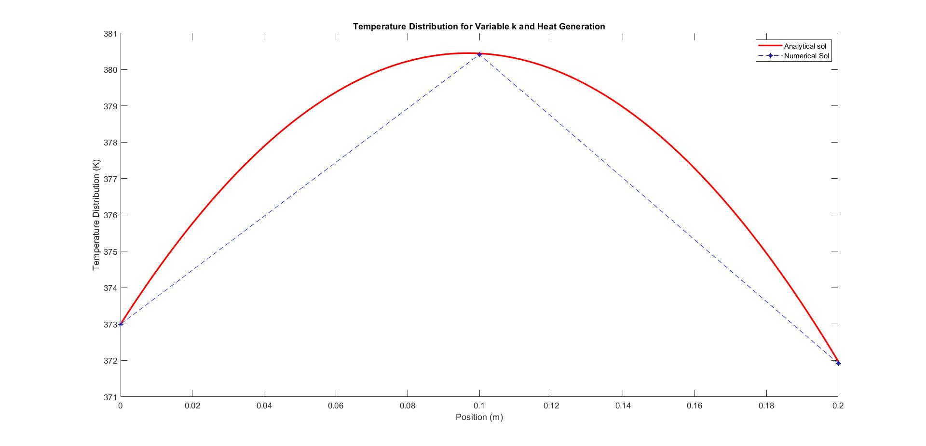
Results: Temperature Distribution and Heat flux for different no. of nodes
For 3 nodes

Slide 21
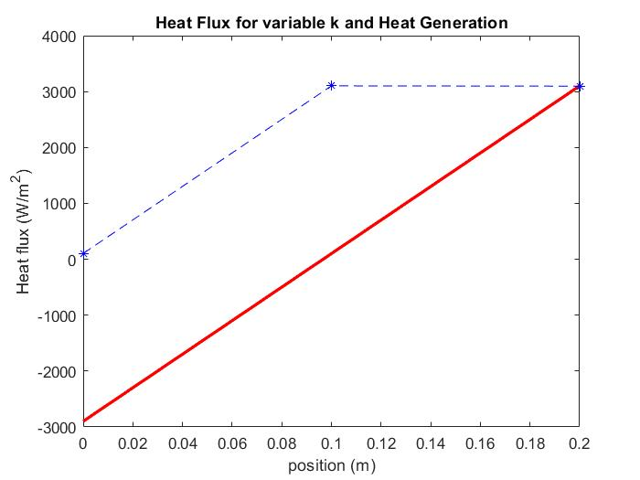

Slide 22
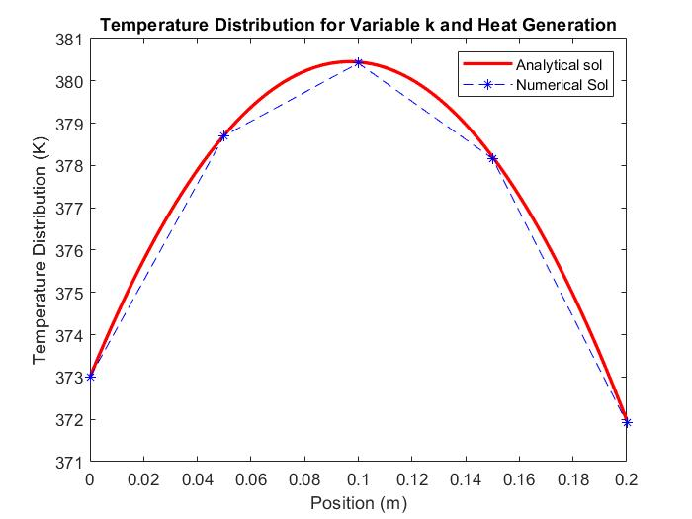
For 5 nodes

Slide 23
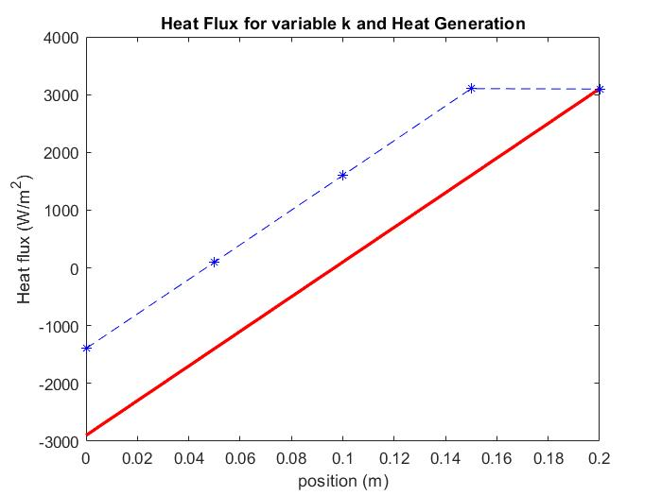

Slide 24
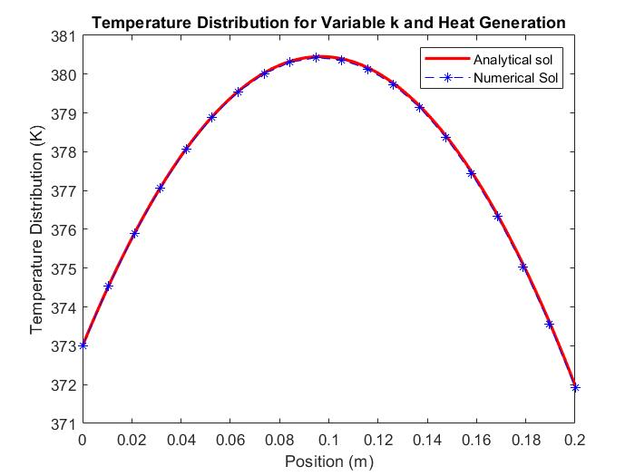
For 20 nodes

Slide 25
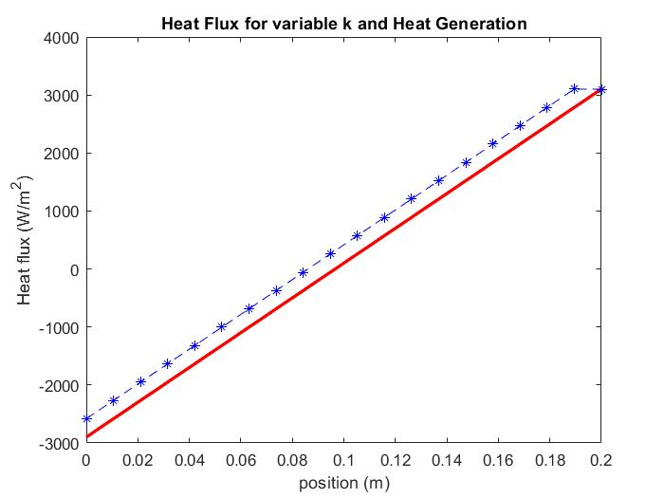
For 20 nodes

Slide 26
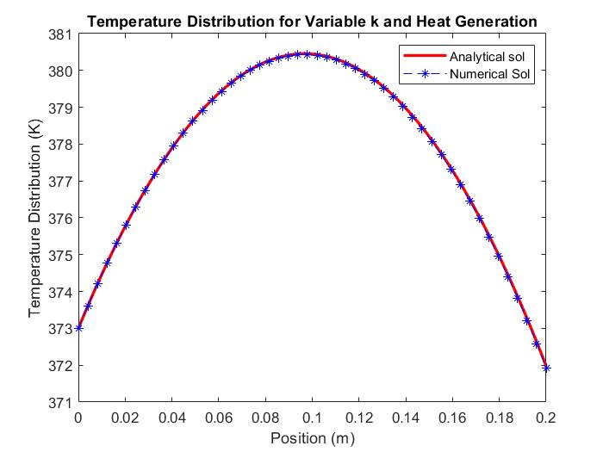
For 50 nodes

Slide 27
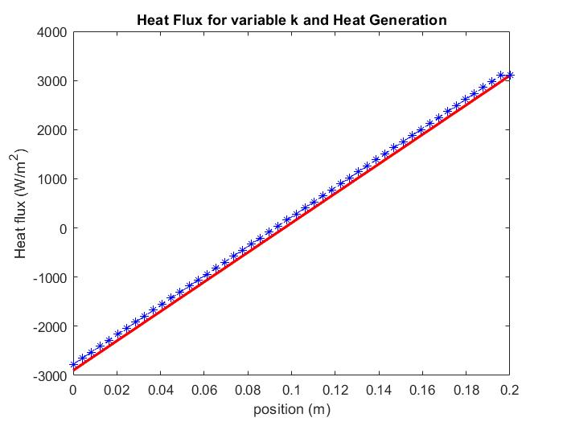
For 50 nodes

Slide 28
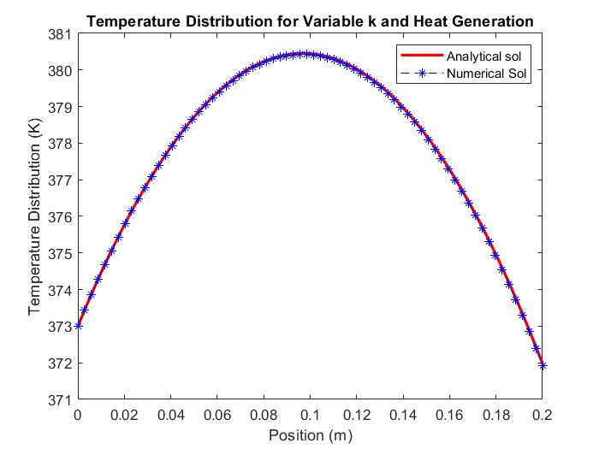
For 70 nodes

Slide 29
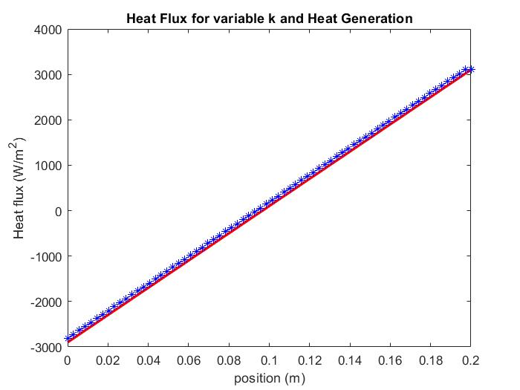
For 70 nodes

Slide 30

For 100 nodes

Slide 31
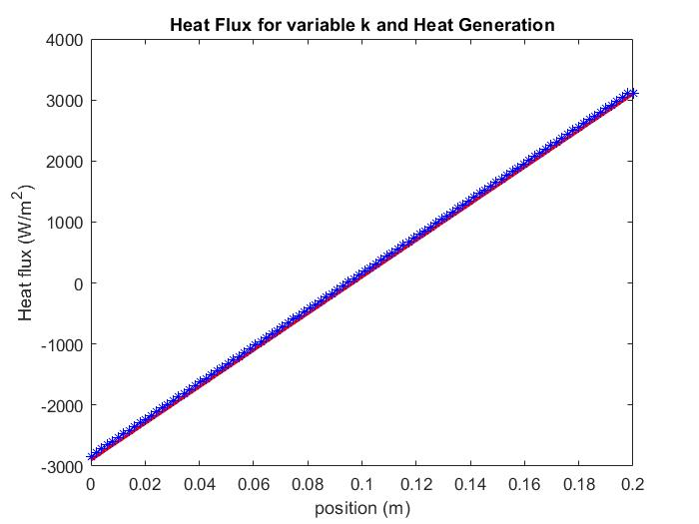
For 100 nodes

Slide 32
Deciding which mesh size is better for accuracy and time consumed
Nodes | Iterations | Time taken (seconds)
3 | 18 | 0.0341
5 | 38 | 0.0344
20 | 863 | 0.153
50 | 5124 | 1.501
70 | 9700 | 3.937
100 | 18959 | 11.07

Slide 33
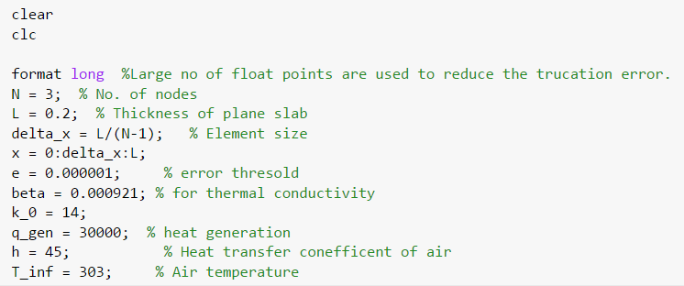
Code: Parameter setup

Slide 34
Analytical solution:

Slide 35
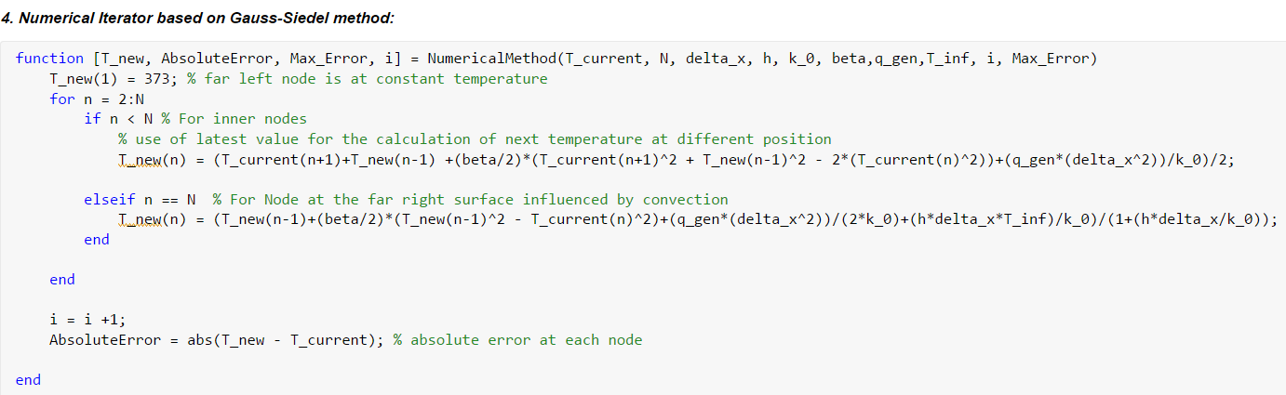
Numerical solution:

Slide 36
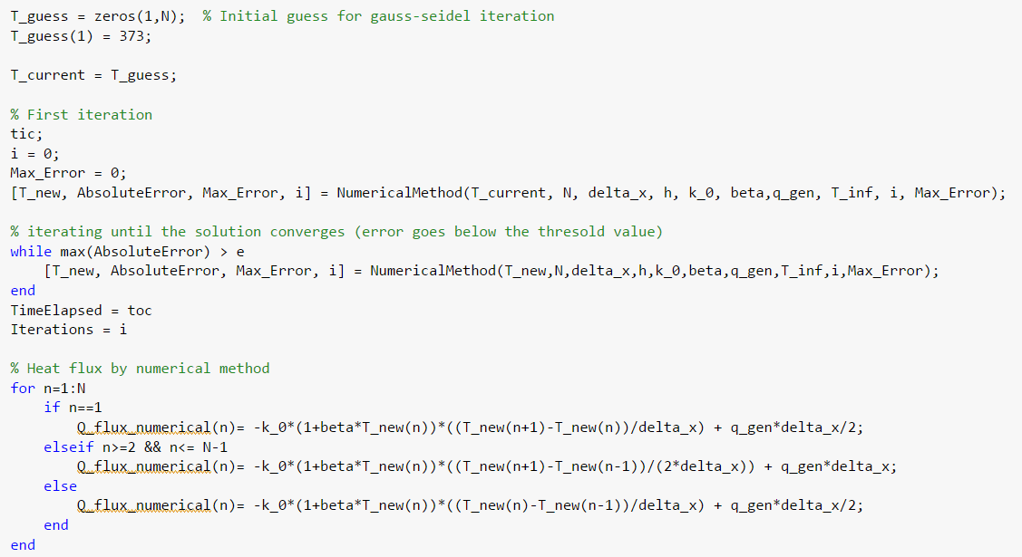
Numerical solution continue…

Slide 37
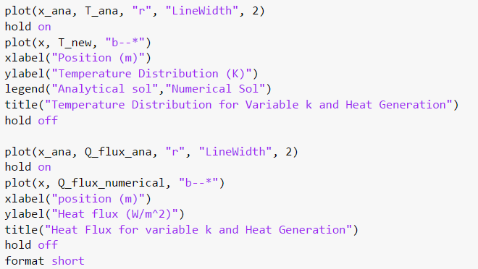
Numerical solution continues…

